Slide 1
Proteins

Slide 2
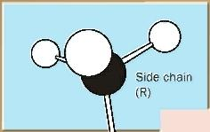
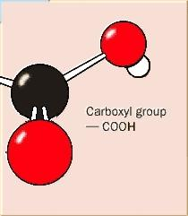
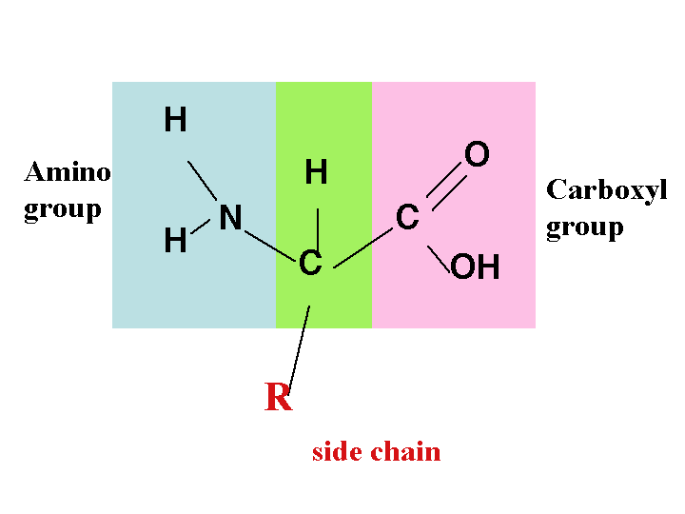

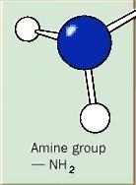
Structure of proteins
Proteins are made of C, H, O and nitrogen and may have sulfur.
The monomers of proteins are amino acids
An amino acid consists of:
  A carbon skeleton
  An amine group NH₂
  A carboxyl group COOH
  One of 20 different ‘R’ groups

Slide 3
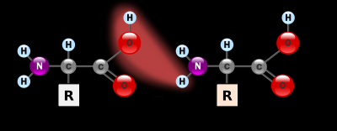

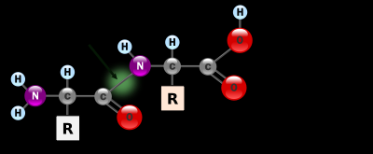
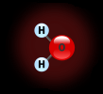
PEPTIDE BONDS
Peptide bonds form between amino acids when water is removed
Peptide Bond

Slide 4
Polypeptides and proteins
A chain of amino acids is called a polypeptide chain.
Proteins consist of one or more polypeptides
E.g. haemoglobin has 2 alpha chains and 2 beta chains

Slide 5
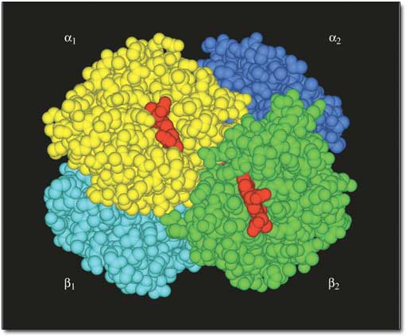
Haemoglobin

Slide 6
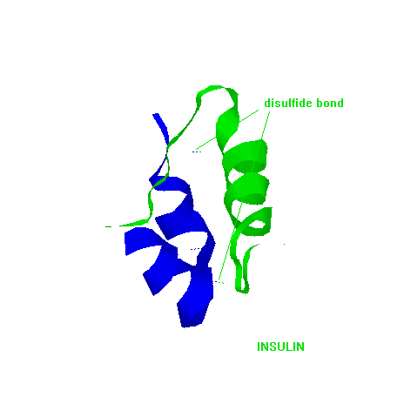
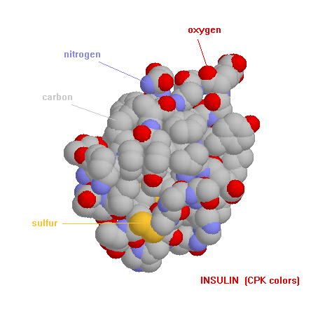
Examples
Insulin – simple model showing disulfide bonds
Insulin – space filling model showing elements

Slide 7
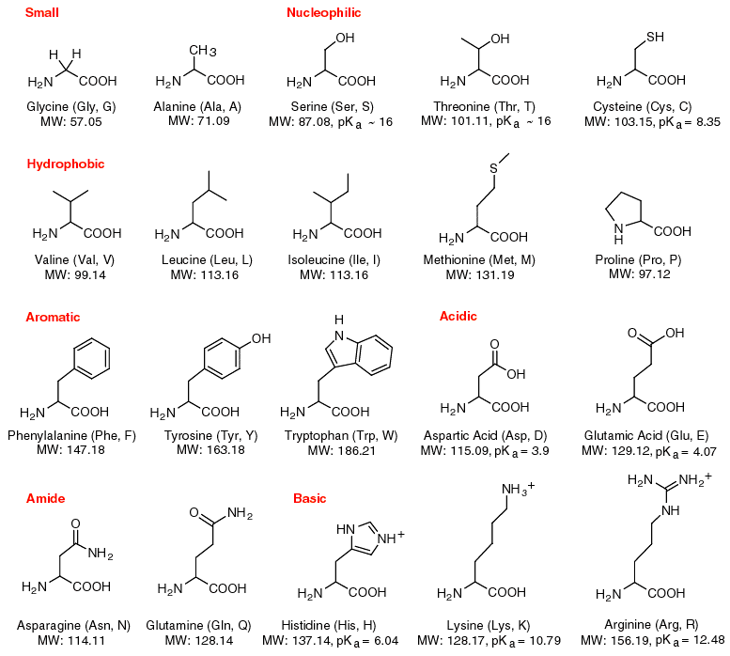
Here are the 20 amino acids, NO you don’t learn them
Gly Ala Ser Thr Cys
Val Leu Ile Met Pro
Phe Tyr Trp Asp Glu
Asn Gln His Lys Arg

Slide 8
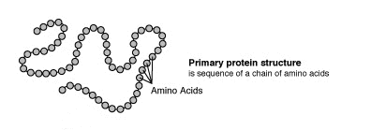
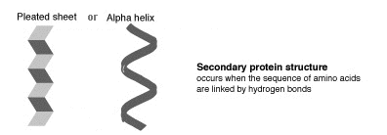
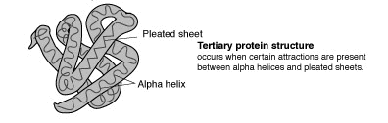
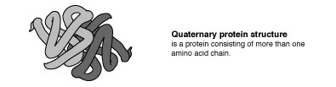
Protein Structure
Simple folding animation

Slide 9
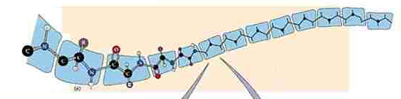
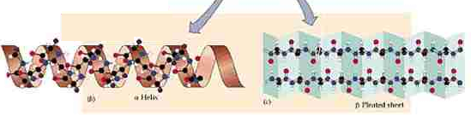
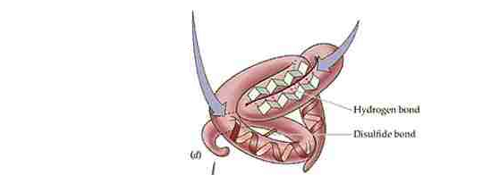
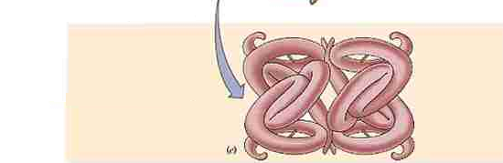
Primary structure The sequence of amino acids
Secondary structure Polypeptide forms α helices or β pleated sheets
Tertiary structure The polypeptide is folded to produce a specific shape
Quaternary structure Two or more polypeptides join to form a functional protein

Slide 10
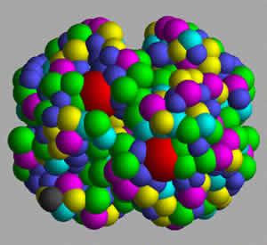
PROTEINS
Have important roles in cells
  Enzymes that catalyse metabolic reactions
  Structural – e.g. hair, nails, connective tissues
  Contraction (actin and myosin in muscle)
  Transportation e.g. haemoglobin (pictured) carries oxygen
  Immunity (antibodies, antitoxins)
  Chemical messengers (hormones)
  Cell membranes

Slide 11
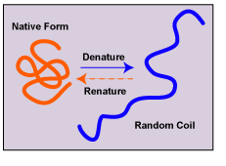
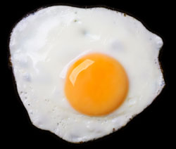
Denaturing
This is damage to the structure of the protein, e.g. “unwinding”
Caused by heat or chemicals
Can be reversible – e.g. change of pH
OR irreversible – e.g. effect of heat (cooking an egg!)

